Slide 1
Chapter 2 Part 5
HTML Elements
(Semantic Elements)

Slide 2
Outline
Page Layout Content sectioning
Traditional HTML Layout
HTML5 Layout Elements
Interactive Elements
iFrame and Portal Elements
Scalar Graphics Vector (SVG)

Slide 3
HTML Semantic Elements

Slide 4
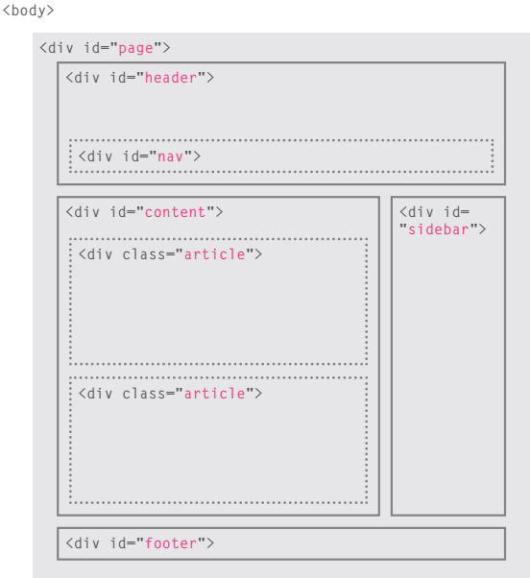
1. Traditional HTML Layout
Content sectioning elements allow you to organize the document content into logical pieces.
For a long time, the <div> element is used to group together related elements on the web page (such as a header, an article, footer or sidebar).
Web developers are used class or id attributes to indicate the role of the <div> element in the structure of the page.

Slide 5
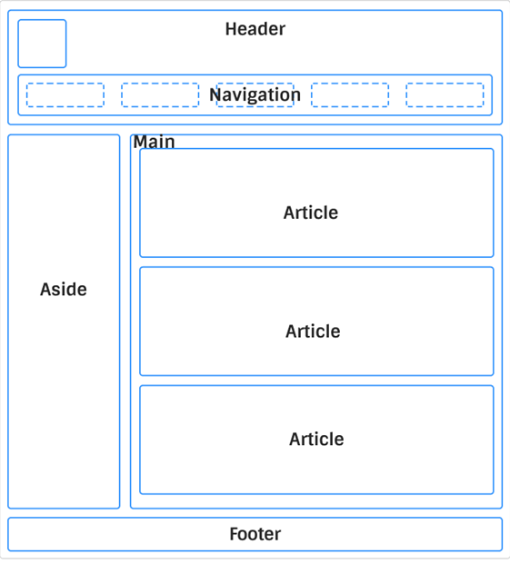
2. HTML5 Layout Elements
HTML5 introduces a new set of elements that allow you to divide up the parts of a page.
The names of these elements indicate the kind of content find in them.
HTML5 content sectioning - semantic elements
Why semantics?
Clearly describes its meaning to both the browser and the developer
Help to structure the code and add readability
header
nav
main
section
article
aside
footer

Slide 6
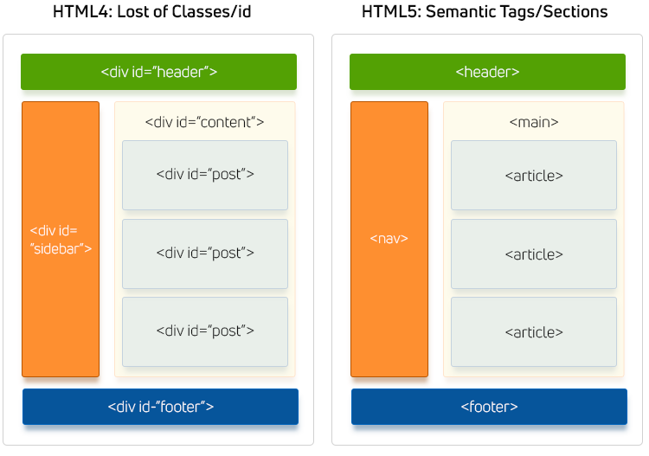
Cont’d
Traditional Layout Vs.
HTML5 Page Layout Elements

Slide 7
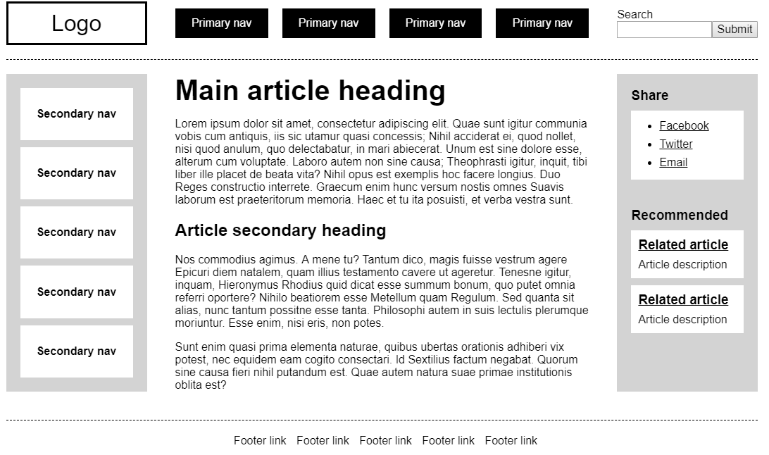
Cont’d
Exercise
Identify the section of the page
Indicate which HTML5 semantic elements are used to define the section

Slide 8
Cont’d
(a) The <header> element
Specifies a header for a document or a section.
For introductory content <header> element should be used as container.
Generally it contains one or more heading elements, logo or icons or author's information.
Several <header> elements can be used in one document,
However, it cannot be placed within a <footer>, <address> or another <header> element.
It is not sectioning content and therefore does not introduce a new section in the outline.
Intended to usually contain the surrounding section's heading (h1–h6 element).

Slide 9
Cont’d
(b) The <footer> element
Specifies a footer for a document or a section.
It is generally used in the last of the section (bottom of the page).
Typically contains information about the
author , contact, and copyright information
Sitemap, back to top links,
Links to related documents etc.
Not sectioning content and therefore doesn't introduce a new section.
To put information like address, e-mail etc. about the author on your web page, all the relevant elements should be included into the footer element.
For example, enclose information about the author in an <address> element that can be included into the <footer> element.

Slide 10
Cont’d
(c) The <nav> element
Represents a section of a page whose purpose is to provide navigation links, either within the current document or to other documents.
Common examples of navigation sections are menus, tables of contents, and indexes.
It's not necessary for all links to be contained in a <nav> element.
It is intended only for major block of navigation links; typically the <footer> element often has a list of links.
A document may have several <nav> elements, for example, one for site navigation and one for intra-page navigation.
User agents, such as screen readers, can use this element to determine whether to omit the initial rendering of navigation-only content.

Slide 11
Cont’d
(d) The <main> element
Represents the dominant content of the <body> of a document.
It is written within <body> tag.
It is used to accurately describe the primary content of a page.
Its content should directly related to or expands upon the central topic of a page, or the central functionality of an application.
Doesn’t contribute to the document's outline.
It should be unique to the document and cannot be nested inside other semantic elements like <article>, <aside>, <header>, <footer> elements.
Content that is repeated across other document sections such as sidebars, navigation links, site logos, and search forms shouldn't be included
If the search form is the main function of the page, it can be included.

Slide 12
Cont’d
(e) The <article> element
Defines an independent self-contained content in a document, page, application or a site.
The content makes sense on its own and intended to be independently distributable or reusable (e.g., in syndication).
It generally used on Forum post, a magazine or newspaper article, Blog post, News story, a product card, a user-submitted comment, an interactive widget or gadget, or any other independent item of content
Each <article> should be identified, typically by including a heading (<h1>-<h6> element) as a child of the <article> element.
When an <article> element is nested, the inner element represents an article related to the outer element.

Slide 13
Cont’d
(f) The <section> element
Represents a generic standalone section of a document, which doesn't have a more specific semantic element to represent it.
Sections should always have a heading, with very few exceptions.
When you put your content on a web page, it may contains many chapters, headers, footers, or other sections on a web page that is why HTML <section> tag is used.
Example: A home page could normally be divided into sections for introduction, content, and contact information
To reiterate, each <section> should be identified, typically by including a heading (<h1>-<h6> element) as a child of the <section> element, wherever possible.

Slide 14
Cont’d
(g) The <aside> element
Represents a portion of a document whose content is only indirectly related to the document's main content.
According to W3C definition, the <aside> element represents content that forms the main textual flow of a document.
It frequently presented as sidebars or call-out boxes.
Do not use the <aside> element to tag parenthesized text, as this kind of text is considered part of the main flow.

Slide 15
Cont’d
Example:
Represents

Slide 16
Interactive Elements

Slide 17
3. Interactive Elements
(a) The <details> element
Creates a disclosure widget in which information is visible only when the widget is toggled into an "open" state.
Often used to create an interactive widget that the user can open and close.
By default, the widget is closed.
When open, it expands, and displays the content within.
Any sort of content can be put inside the <details> tag.
A disclosure widget is typically presented onscreen using a small triangle which rotates (or twists) to indicate open/closed status, with a label next to the triangle.

Slide 18
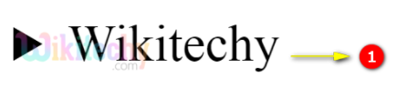
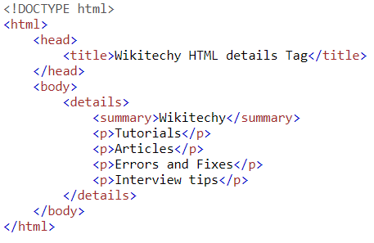
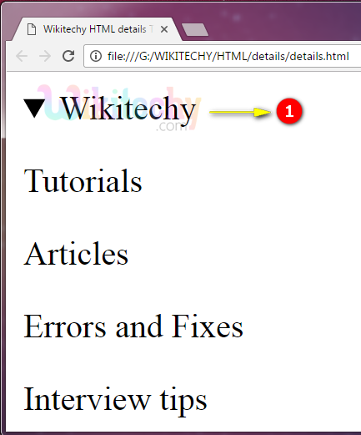
Cont’d
(b) The <summary> element
Defines a visible heading for the <details> element.
The heading can be clicked to view/hide the details.
It should be the first child element of the <details> element.
Summary
Details

Slide 19
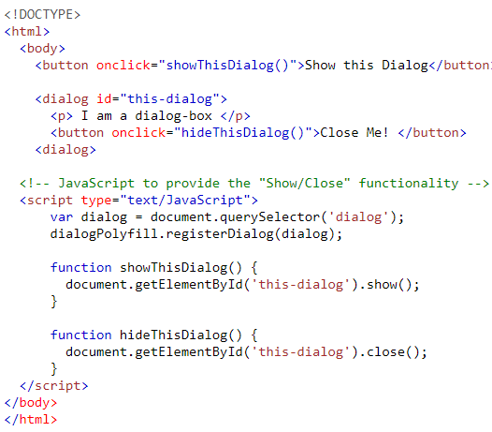
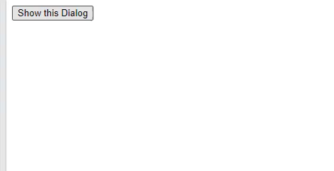
Cont’d
(c) The <dialog> element
Represents a dialog box or other interactive component, such as a dismissible alert, inspector, or sub-window.
Makes it easy to create popup dialogs and modals on a web page

Slide 20
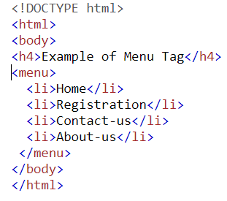
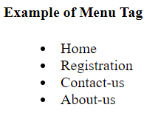
Cont’d
(d) The <menu> element
Specifies a list or menu of commands that a user can perform or activate.
It is used for creating context menu as well as lists menu.
It is a semantic alternative to <ul>.
It represents an unordered list of items (represented by <li> elements.
It can contain one or more <li> elements within it.
It is different from <ul> element that it intended for interactive items, to act on whilst <ul> primarily contains items for display.

Slide 21
Embedded Contents

Slide 22
4. Embedded Elements
(a) The <iframe> element
Represents a nested browsing context, embedding another HTML page into the current one (a webpage within a webpage).
Defines an inline frame, hence it is also called as an Inline frame.
It embeds another document within the current HTML document in the rectangular region.
The webpage content and iframe contents can interact with each other using JavaScript.
Each embedded browsing context has its own session history and document.
The browsing context that embeds the others is called the “parent browsing context”.

Slide 23
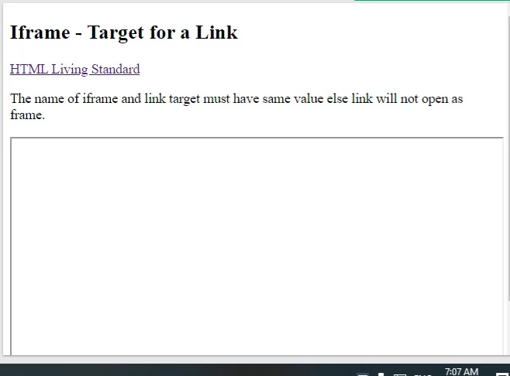
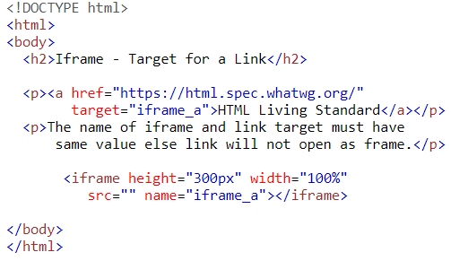
Cont’d
Syntax:
<iframe src="URL"></iframe>
- "src" attribute specifies the web address (URL) of the inline frame page.
Example 1:

Slide 24
Cont’d
Most Common iFrame Attributes
Attribute | Value | Description
allow |  | Specifies a feature policy for the <iframe>
src | URL | Specifies the address of the document to embed in the <iframe>
srcdoc | HTML_code | Specifies the HTML content of the page to show in the <iframe>
height, width | pixels | Specifies the height and width of an <iframe> respectively. Default height and width are 150 pixels and 300 pixels respectively.
name | text | Specifies the name of an <iframe>
allowfullscreen | true false | Set to true if the <iframe> can activate fullscreen mode by calling the requestFullscreen() method
allowpayment request | true false | Set to true if a cross-origin <iframe> should be allowed to invoke the Payment Request API
loading | eager lazy | Specifies whether a browser should load an iframe immediately or to defer loading of iframes until some conditions are met

Slide 25
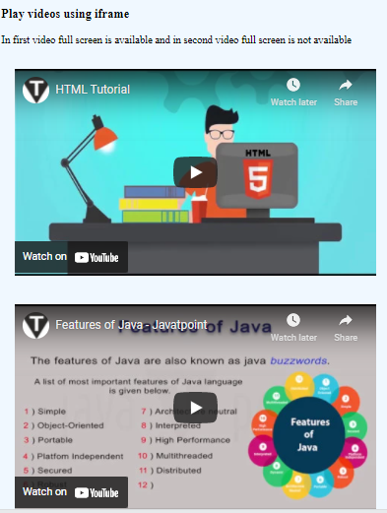
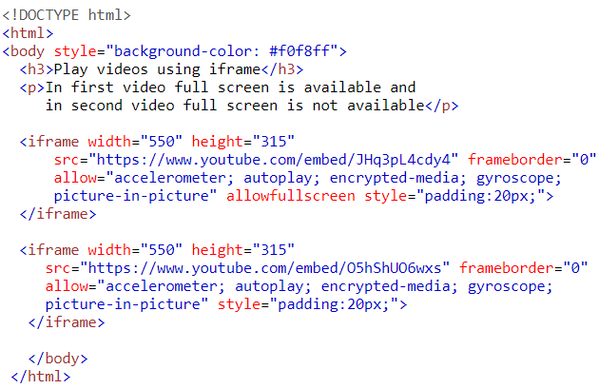
Cont’d
Example 2: Embed YouTube video using iframe
Note
It is a good practice to always include a title attribute for the <iframe> which used by screen readers to read out what the content of the <iframe> is.

Slide 26
HTML Graphics (Reading)
The <canvas> element
The <SVG> element

Slide 27
Summary
The new HTML5 elements indicate the purpose of different parts of a web page and help to describe its structure.
The new elements provide clearer code (compared with using multiple <div> elements).
HTML5 semantic elements include <header>, <nav>, <main>, <section>, <article>, <aside>, <footer>.
Older browsers that do not understand HTML5 elements need to be told which elements are block-level elements.
To make HTML5 elements work in Internet Explorer 8 (and older versions of IE), extra JavaScript is needed, which is available free from Google.

Slide 28
Summary
If the contents of the element represent a standalone, atomic unit of content that makes sense syndicated as a standalone piece (e.g. a blog post or blog comment, or a newspaper article), the <article> element would be a better choice.
If the contents represent useful tangential information that works alongside the main content, but is not directly part of it (like related links, or an author bio), use an <aside>.
If the contents represent the main content area of a document, use <main>.
If you are only using the element as a styling wrapper, use a <div>.
A rule of thumb is that a <section> should logically appear in the outline of a document.

Slide 29
Summary
Image
Image map
Picture
Audio
Video
Multimedia Elements
Link elements
Image tag
Figure tag
Figurecaption tag

